Slide 1



The Slope-Intercept Form
by Todd Nash

Slide 2
y = mx + b
Ok, y is usually the final value in an equation. It's based on two parts... mx and b. If x goes up by 1 let's say, we only change y by... m.
Hrm, let's try an example. If m=.3, and x goes from 0 to 10, we go up by 10 * .3 = 3. Ok. Got that part.
Now what does b do? It adds something on top of whatever we just figured out. If x = 0, I guess we just have y = b.
by Todd Nash

Slide 3
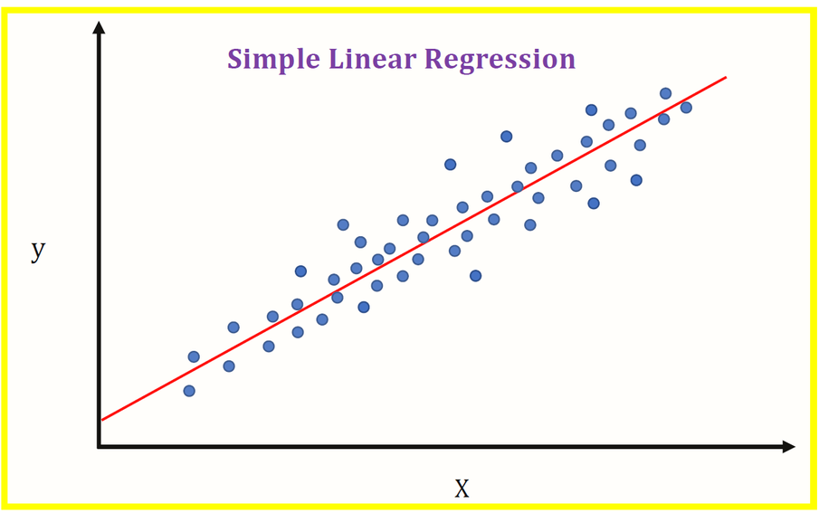
Bivariate Scenario
Linear regression is one of the fundamental techniques in machine learning, and it aims to find the best-fitting straight line that describes the relationship between the independent variable (input) and dependent variable (output) in a dataset.
by Todd Nash

Slide 4

Math Notation
m (slope)
b (y-intercept)
In plain English:
b is our starting point
x is the change we intend to make
m is the percentage (rate) of the change (Δ) we actually see
by Todd Nash

Slide 5
Why is it important?
After training a linear regression model with known data, you can use the learned coefficients (𝑚 and 𝑏) to predict the corresponding 𝑦 values (output) for new 𝑥 values (input). However, it's important to note that the accuracy of these predictions depends on the assumptions of the linear regression model and the quality of the training data.
*Coefficients refer to the values that are multiplied by the independent variables (features) to determine the predicted value of the dependent variable (target). In the equation of a straight line,y=mx+b, the coefficient 'm' represents the slope of the line, and 'b' represents the y-intercept.
by Todd Nash
Notes:
More generally, in the equation of a linear regression model with multiple features, the coefficients represent the weights assigned to each feature. These coefficients determine the contribution of each feature to the prediction of the target variable. For example, in a simple linear regression model with two features x1 and x2, the equation would be:
y = b0 + b1 * x1 + b2 * x2
Here:
b0 is the intercept term.
b1 and b2 are the coefficients associated with x1 and x2 respectively.
These coefficients are learned during the training process of the linear regression model. The goal of training is to find the optimal values for the coefficients that minimize the difference between the predicted values and the actual values of the target variable in the training data.

Slide 6
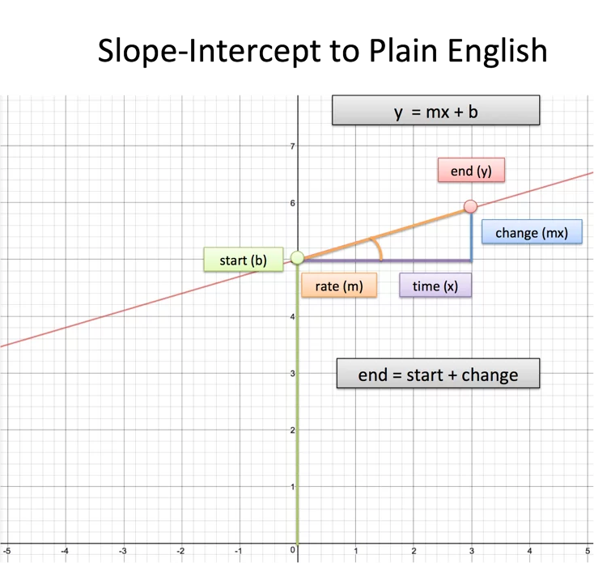
by Todd Nash

Slide 7
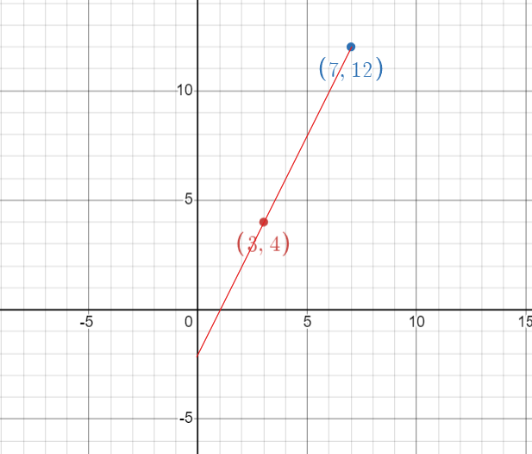
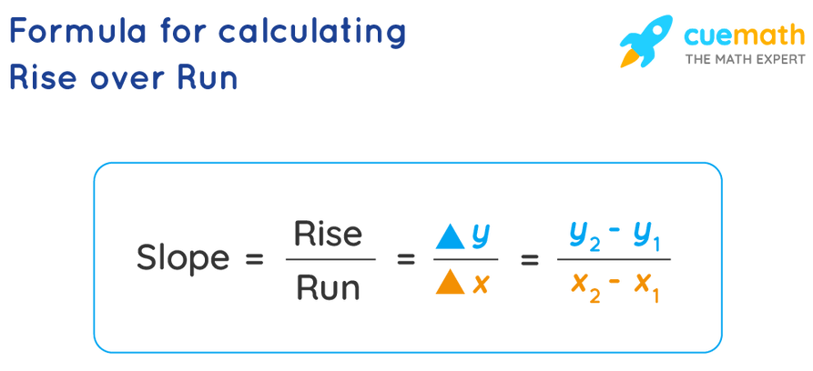
Example: Find the slope-intercept form between two points
Q: Find the equation for a line between (3, 4) and (7, 12)
*position = start + change
For the two points we have, let's look at the change:
Change in x: 7 - 3 = 4
Change in y: 12 - 4 = 8
by Todd Nash

Slide 8
Example: Find the slope-intercept form between two points
Q: Find the equation for a line between (3, 4) and (7, 12)
Between those points, x changed by 4 and y changed by 8.
The rate was 8/4 = 2, so the equation should look like:
position = start + x * 2
We don't know where we started, but whenever x changes, y changes by 2 times that amount.
by Todd Nash

Slide 9
Example: Find the slope-intercept form between two points
Q: Find the equation for a line between (3, 4) and (7, 12)
Well, if x changed by 3, and the rate of change is 2, then y changed by 3*2 = 6. The original value was therefore 4 - 6 = -2.
Original point is (0, -2)
The final equation is then:
position = start + change
position = start + x * 2
position = -2 + x * 2
by Todd Nash

Slide 10
Example: Find the slope-intercept form between two points
Q: Find the equation for a line between (3, 4) and (7, 12)
...and written in more standard y = mx + b notation,
y = 2x - 2
Let's double check. We start at (0, -2) and go 3 units on the x coordinate. Our final position is 2*3 - 2 = 6 -2 = 4, which matches up with (3, 4).
by Todd Nash

